Slide 1
Learning Activity 1.4.2
Image 1
UN Core Pre-Deployment Training Materials 2017

Slide 2
Learning Activity 1.4.2
Image 2
UN Core Pre-Deployment Training Materials 2017

Slide 3
Learning Activity 1.4.2
Image 3
UN Core Pre-Deployment Training Materials 2017

Slide 4
Learning Activity 1.4.2
Image 4
UN Core Pre-Deployment Training Materials 2017

Slide 5
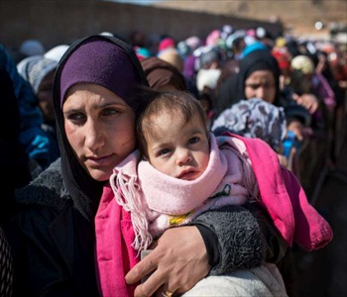
Learning Activity 1.4.3
Image 1
UN Core Pre-Deployment Training Materials 2017

Slide 6
Learning Activity 1.4.3
Image 2
UN Core Pre-Deployment Training Materials 2017

Slide 7
Learning Activity 1.4.3
Image 3
UN Core Pre-Deployment Training Materials 2017

Slide 8
Learning Activity 1.4.3
Image 4
UN Core Pre-Deployment Training Materials 2017

Slide 9
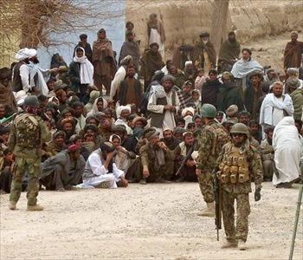
Learning Activity 1.4.3
Image 5
UN Core Pre-Deployment Training Materials 2017

Slide 10
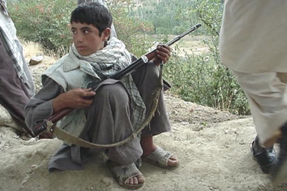
Learning Activity 1.4.3
Image 6
UN Core Pre-Deployment Training Materials 2017

Slide 11
Learning Activity 1.4.3
Image 7
UN Core Pre-Deployment Training Materials 2017

Slide 12
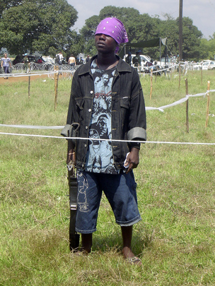
Learning Activity 1.4.3
Image 8
UN Core Pre-Deployment Training Materials 2017

Slide 13
Learning Activity 1.4.3
Image 9
UN Core Pre-Deployment Training Materials 2017

Slide 14
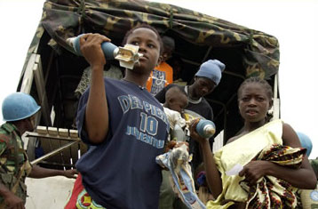
Learning Activity 1.4.3
Image 10
UN Core Pre-Deployment Training Materials 2017

Slide 15
Learning Activity 1.4.3
Image 11
UN Core Pre-Deployment Training Materials 2017

Slide 16
Learning Activity 1.4.3
Image 12
UN Core Pre-Deployment Training Materials 2017

Slide 17
Learning Activity 1.4.3
Image 13
UN Core Pre-Deployment Training Materials 2017

Slide 18
Learning Activity 1.4.3
Image 14
UN Core Pre-Deployment Training Materials 2017

Slide 19
Learning Activity 1.4.3
Image 15
UN Core Pre-Deployment Training Materials 2017

Slide 20
Learning Activity 1.4.3
Image 16
UN Core Pre-Deployment Training Materials 2017

Slide 21
Learning Activity 1.4.3
Image 17
UN Core Pre-Deployment Training Materials 2017

Slide 22
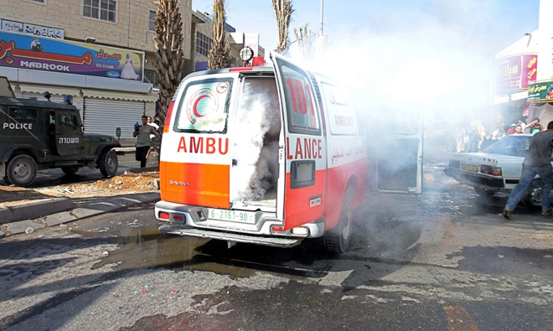
Learning Activity 1.4.3
Image 18
UN Core Pre-Deployment Training Materials 2017

Slide 23
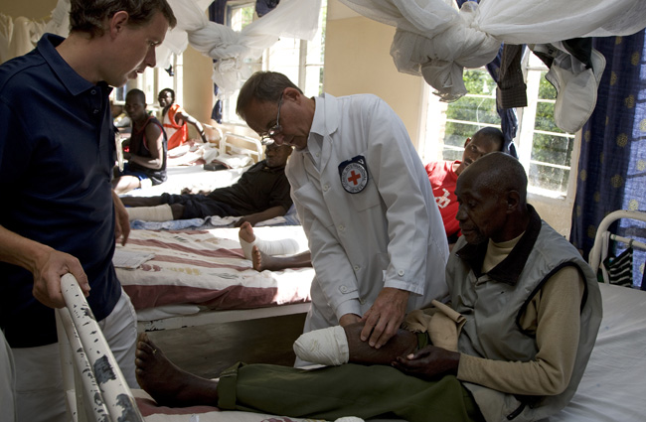
Learning Activity 1.4.3
Image 19
UN Core Pre-Deployment Training Materials 2017

Slide 24
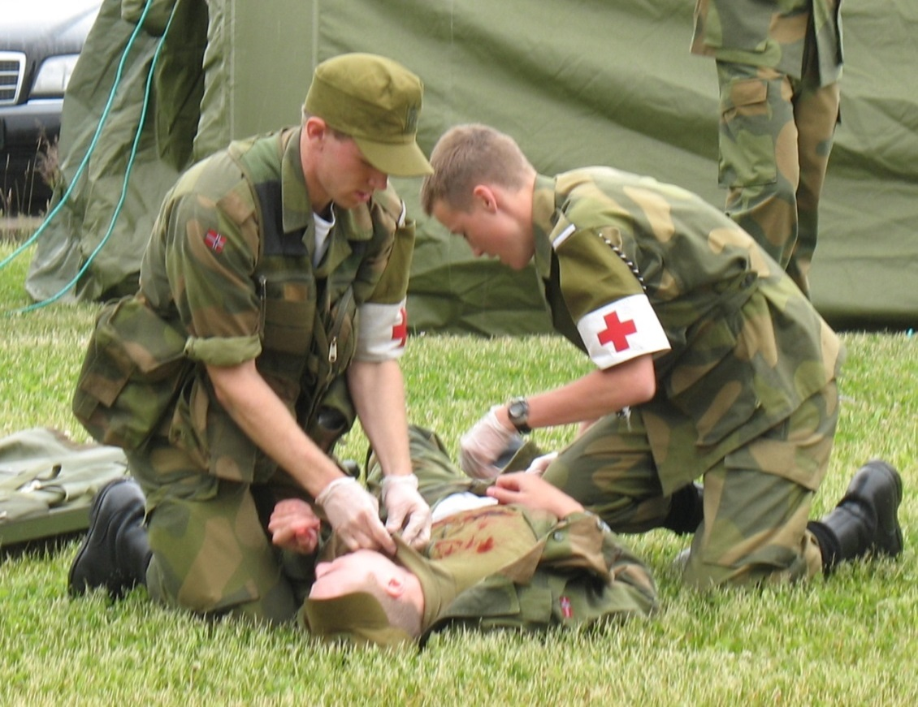
Learning Activity 1.4.3
Image 20
UN Core Pre-Deployment Training Materials 2017

